Slide 1
E6156 – Topics in SW Engineering: Cloud Computing
Lecture 5: APIGW, Lambda, SSO, Events
© Donald F. Ferguson, 2021

Slide 2

Contents
2 | E6156 – Topics in SW Engineering: Lecture 5: APIs, Lambda, SSO, Events © Donald F. Ferguson, 2021

Slide 3
Agenda
Level set – a microservice walkthrough
What do you actually get when receiving a REST call?
Implementing REST paths
Dependency injection
CORS
REST/HATEOAS:
Concepts
Deep dive on “stateless”
Middleware
Event Driven Processing
Lambda functions
Webhooks

Slide 4
Code to Show Today
4 | E6156 – Topics in SW Engineering: Lecture 5: APIs, Lambda, SSO, Events © Donald F. Ferguson, 2021

Slide 5
Code to Show
/demo path and rest_utils (UserProfileNew)
oauth-python project, including setup on GCP.
UserProfileNew
Pagination
Fields
Links
Middleware
Lambda function.
WebHook

Slide 6
Microservice Walkthrough
6 | E6156 – Topics in SW Engineering: Lecture 5: APIs, Lambda, SSO, Events © Donald F. Ferguson, 2021

Slide 7
REST Method
When your handler receives a REST operation, there are the following elements. Not all methods have all elements:
Path
Path parameters
Query string parameters
Headers
Body
The REST handler’s response has the following elements:
Status code
Body
Headers
The route handler maps between the REST representation of the elements and the language/runtime representation.
Flask provides access through the
Request object.
Response object.
Walkthrough

Slide 8
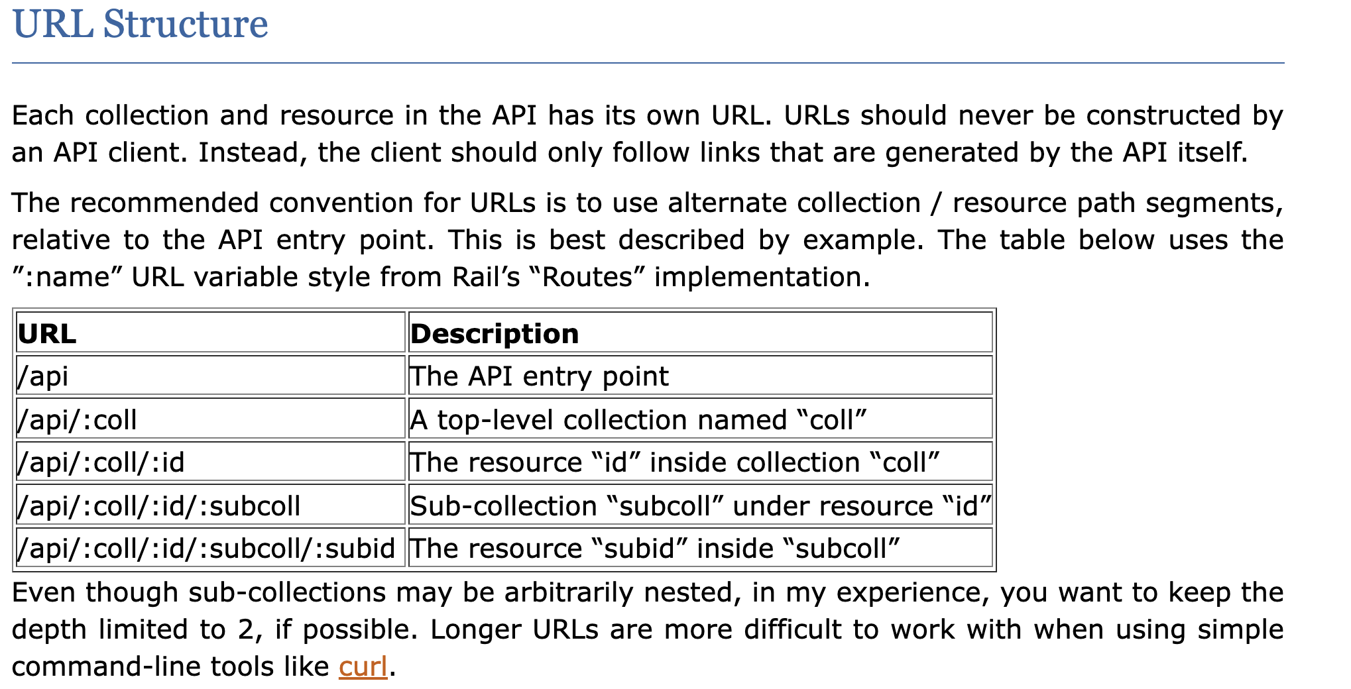
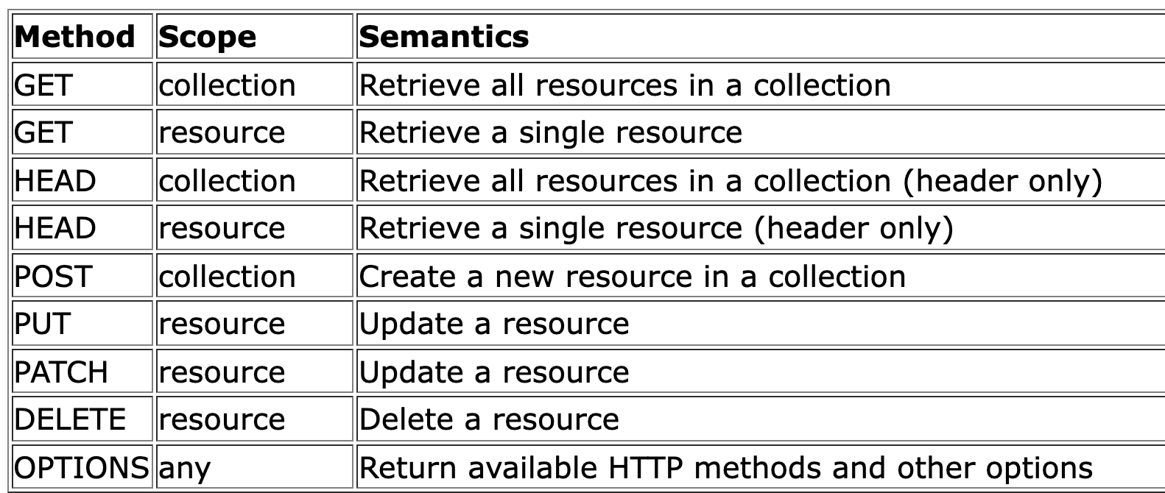
REST Paths
https://restful-api-design.readthedocs.io/en/latest/
There are many patterns. I typically follow something like:
We will not be too rigorous about status codes, but some common examples are:
200: OK (success)
201: CREATED (for POST)
404: NOT FOUND
500: INTERNAL SERVICE ERROR
418: I’M A TEAPOT

Slide 9
Success Response Codes
202 means
Your request went asynch.
The HTTP header Link is where to poll for rsp.
Operation | HTTP Request | HTTP Response Codes Supported
READ | GET | 200 - OK with message body 204 - OK no message body 206 - OK with partial message body
CREATE | POST | 201 - Resource created (Operation Complete) 202 - Resource accepted (Operation Pending)
UPDATE | PUT | 202 - Accepted (Operation Pending) 204 - Success (Operation Complete)
DELETE | DELETE | 202 - Accepted (Operation Pending) 204 - Success (Operation Complete)
Examples of Link Headers in HTTP response:
Link: <http://api/jobs/j1>;rel=monitor;title="update profile"
Link: <http://api/reports/r1>;rel=summary;title=”access report”

Slide 10
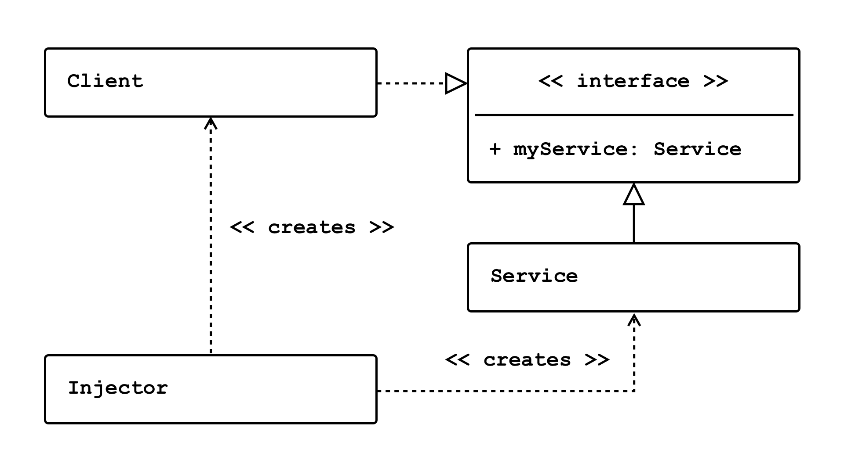
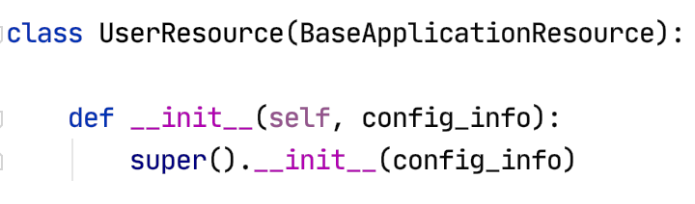
Dependency Injection
Concepts (https://en.wikipedia.org/wiki/Dependency_injection):
In software engineering, dependency injection is a technique in which an object receives other objects that it depends on, called dependencies.
The intent behind dependency injection is to achieve separation of concerns of construction and use of objects. This can increase readability and code reuse.
There is no single approach. There are several frameworks, tools, etc.
Like many other things, it is easy to get carried away and become dogmatic.
I follow a single approach:
A Context class converts environment and other configuration and provides to application.
The top-level application injects a config_info object into services.

Slide 11
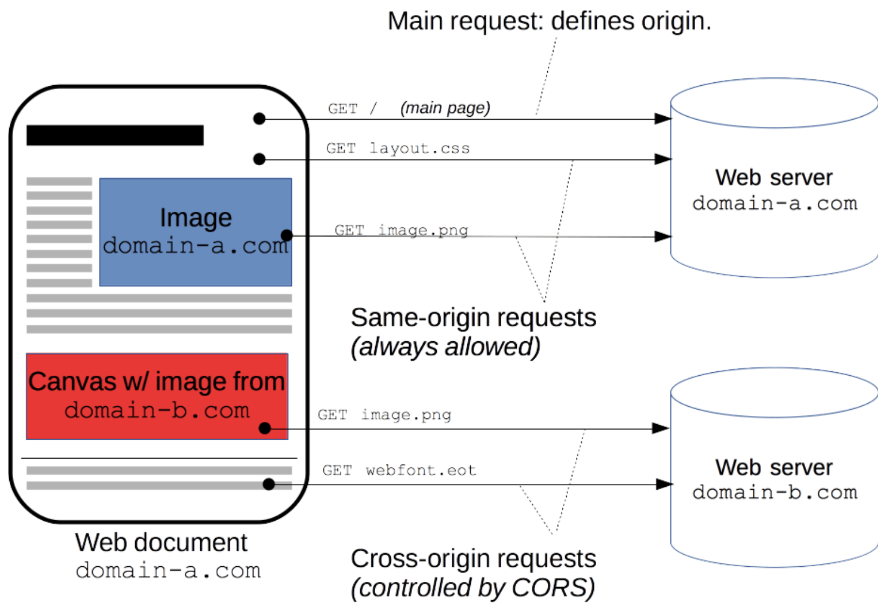
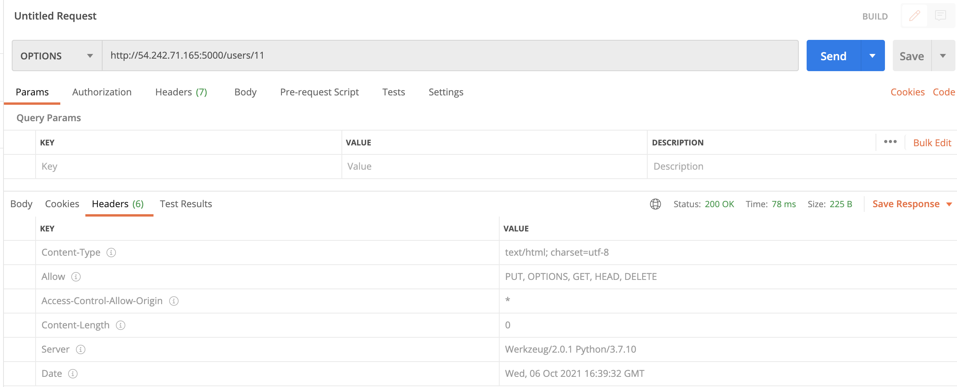
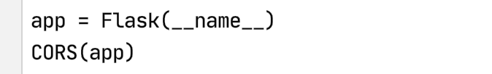
CORS
https://developer.mozilla.org/en-US/docs/Web/HTTP/CORS
“For security reasons, browsers restrict cross-origin HTTP requests initiated from scripts. For example, XMLHttpRequest and the Fetch API follow the same-origin policy. This means that a web application using those APIs can only request resources from the same origin the application was loaded from unless the response from other origins includes the right CORS headers.”

Slide 12
/api

Slide 13
REST Principles HATEOAS
13 | E6156 – Topics in SW Engineering: Lecture 4: APIs, REST, SSO, Events © Donald F. Ferguson, 2021

Slide 14
REST Principles
REST Principles:
Uniform interface
Client–server
Stateless
Cacheable
Layered system
Code on demand (optional)
Many of these are straightforward. We will explore some of the concepts in various lectures.
Today, we cover “statelessness.”
HATEOAS: Hypertext as the Engine of Application State --
The principle is that a client interacts with a network application entirely through hypermedia provided dynamically by application servers. A REST client needs no prior knowledge about how to interact with any particular application or server beyond a generic understanding of hypermedia.

Slide 15
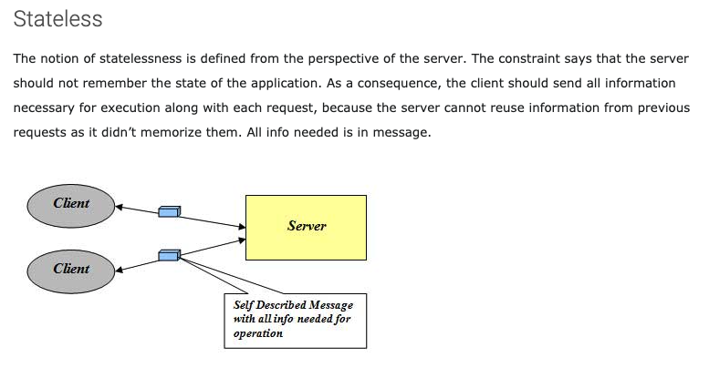
Stateless
http://mrbool.com/rest-architectural-elements-and-constraints/29339

Slide 16
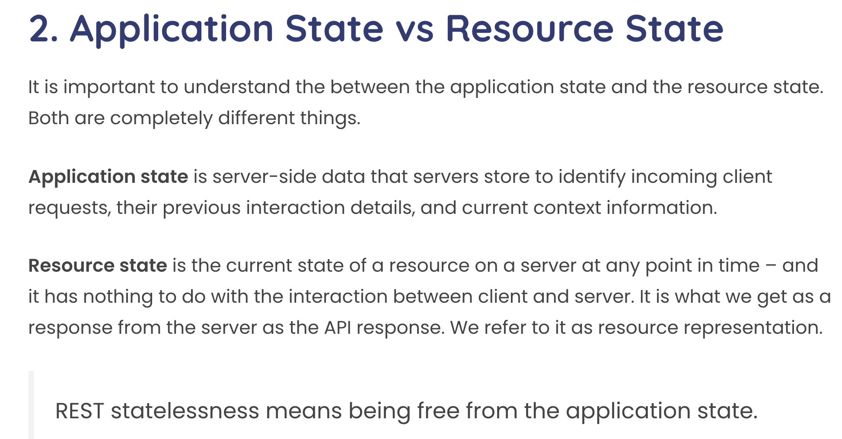
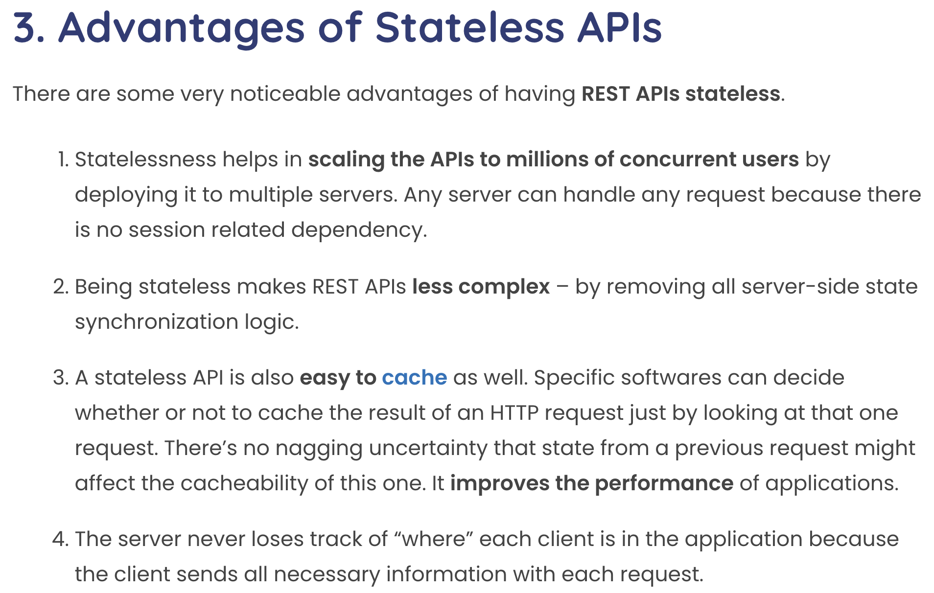
Statelessness
This concept can be confusing with experience with other approach to session state.
Some application frameworks did/do keep session state on the server.
Application servers and frameworks have various support for “session state,” e.g. https://flask-session.readthedocs.io/en/latest/

Slide 17
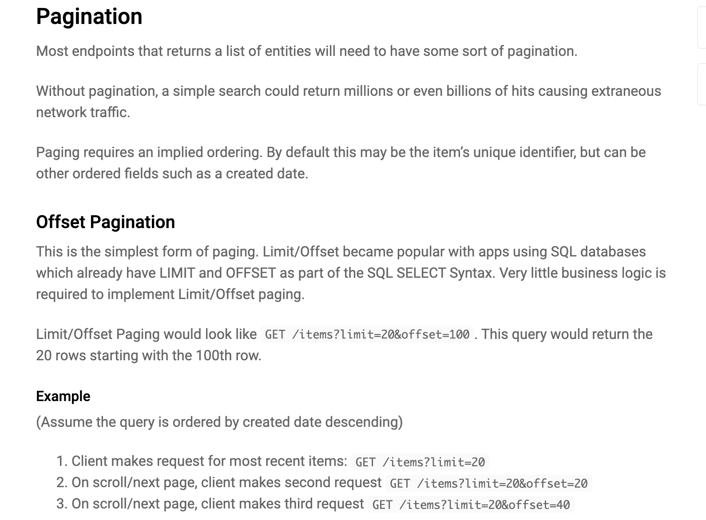
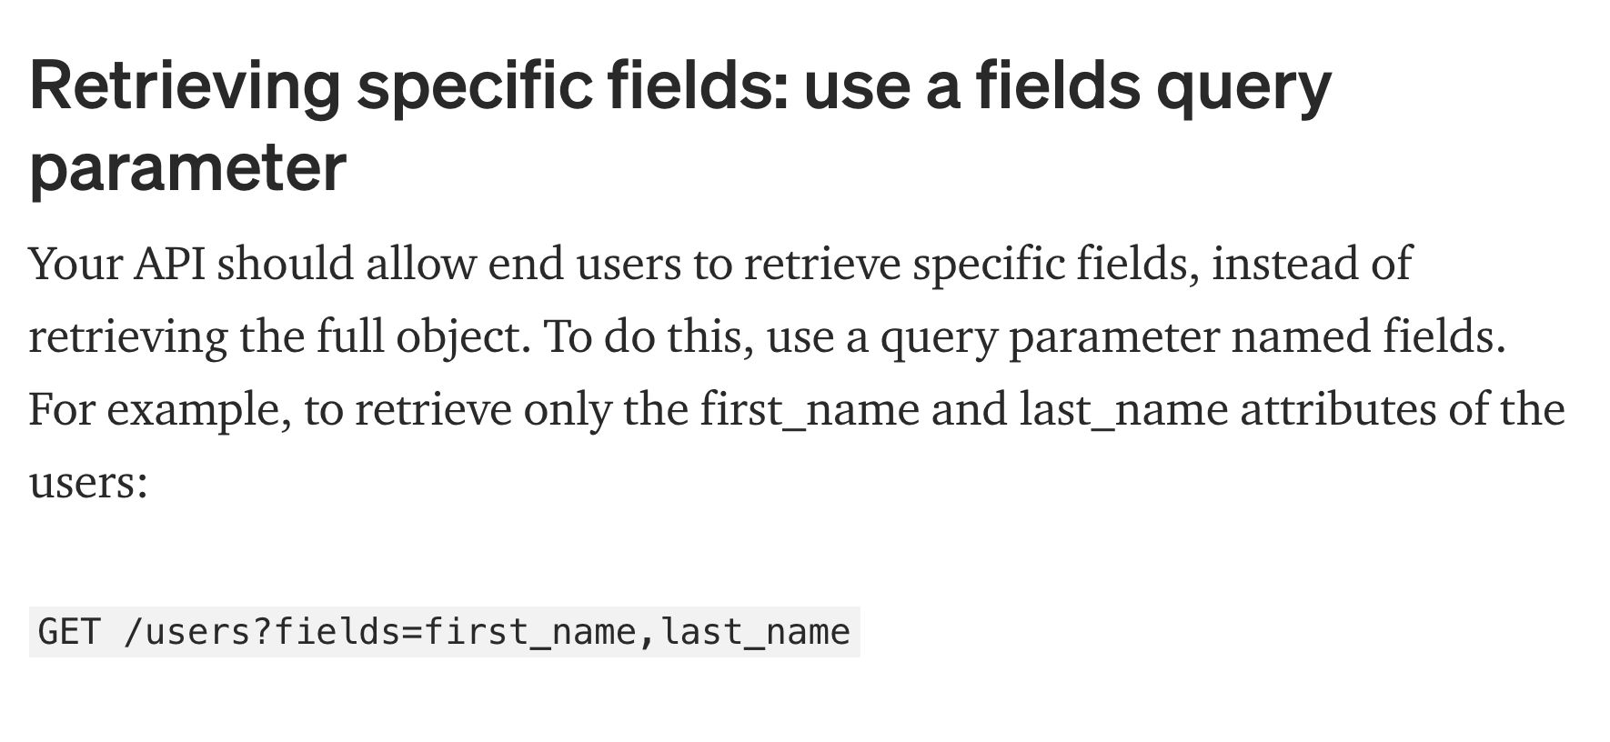
Pagination and Field Selection
https://www.moesif.com/blog/technical/api-design/REST-API-Design-Filtering-Sorting-and-Pagination/

Slide 18
Middleware
18 | E6156 – Topics in SW Engineering: Lecture 5: APIs, Lambda, SSO, Events © Donald F. Ferguson, 2021

Slide 19
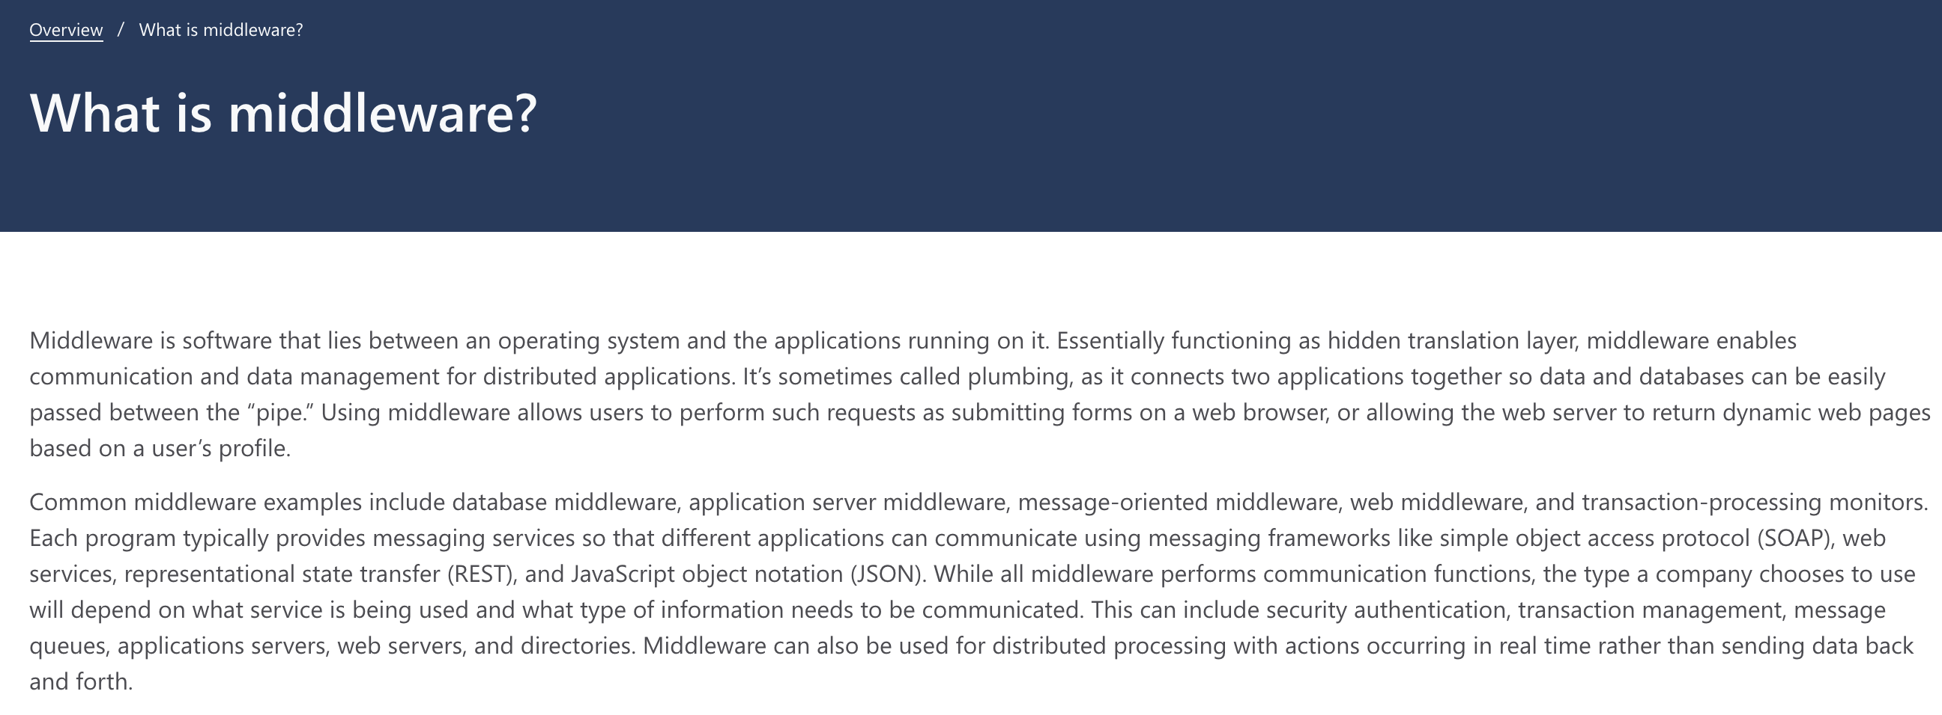
Middleware

Slide 20
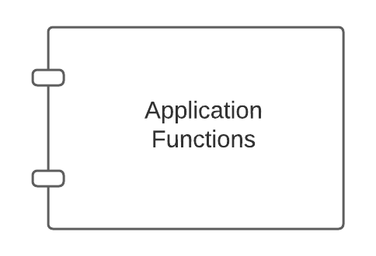
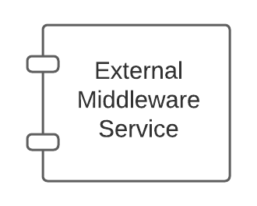
Middleware – Conceptual Model
There are app server specific approaches to injecting into the applications.

Slide 21
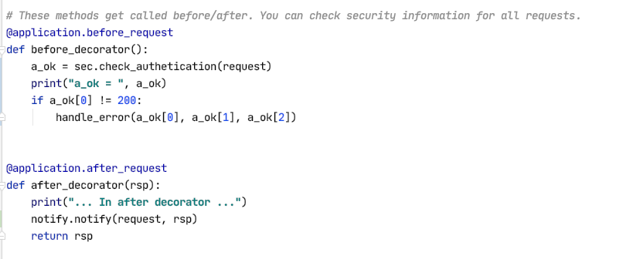
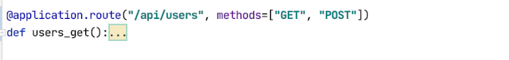
Middleware and Flask
White list of URLs
If not on white list:
Verify token
Verify authorization
List of filters of the form:
URL
HTTP Method
SNS topic to use
Send an event to SNS if matches filter
Show some demo code.

Slide 22
So, How Will We Use This?
Add before_request and after_request to microservices. (Note: There are other approaches).
Implement two middleware interceptors:
Security
Configured with a JSON file.
File lists which {path, method} require being logged on.
While IDs can perform which methods on which paths.
Automates driving login redirect (401 – Unauthorized)
Checks authorization (403– Forbidden)
Notification:
Configured with JSON file.
File lists which operations emit a before and/or after event to an SNS topic.
We will use notification to drive some other things like webhooks.

Slide 23
Event Drive Processing Publish/Subscribe
23 | E6156 – Topics in SW Engineering: Lecture 5: APIs, Lambda, SSO, Events © Donald F. Ferguson, 2021

Slide 24
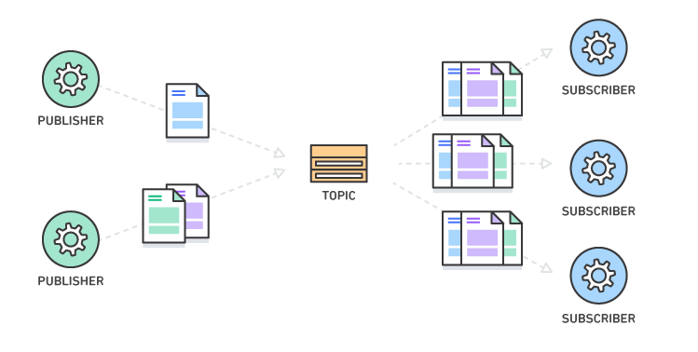
Pub/Sub – Event Driven Processing
“In software architecture, publish–subscribe is a messaging pattern where senders of messages, called publishers, do not program the messages to be sent directly to specific receivers, called subscribers, but instead categorize published messages into classes without knowledge of which subscribers, if any, there may be. Similarly, subscribers express interest in one or more classes and only receive messages that are of interest, without knowledge of which publishers, if any, there are.
Publish–subscribe is a sibling of the message queue paradigm, and is typically one part of a larger message-oriented middleware system. Most messaging systems support both the pub/sub and message queue models in their API, e.g. Java Message Service (JMS).
This pattern provides greater network scalability and a more dynamic network topology, with a resulting decreased flexibility to modify the publisher and the structure of the published data.”
It also support loose coupling for application evolution and agility.
I can add and evolve services without modifying the services.
https://en.wikipedia.org/wiki/Publish%E2%80%93subscribe_pattern

Slide 25
Pub/Sub – Simple Notification Service
25 | E6156: Topics in SW Engineering – Cloud Computing/BaaS

Slide 26
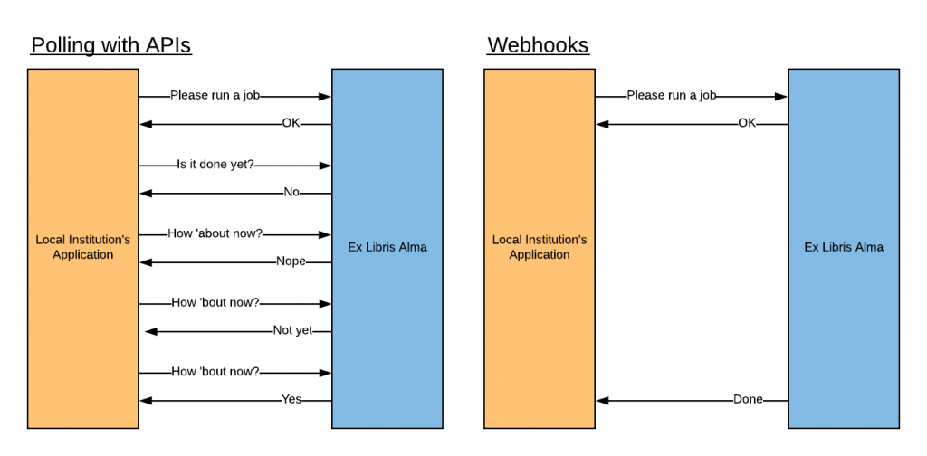
Webhooks
“A webhook in web development is a method of augmenting or altering the behavior of a web page or web application with custom callbacks. These callbacks may be maintained, modified, and managed by third-party users and developers who may not necessarily be affiliated with the originating website or application. The term "webhook" was coined by Jeff Lindsay in 2007 from the computer programming term hook.”

Slide 27
Function-as-a-Service
27 | E6156 – Topics in SW Engineering: Lecture 5: APIs, Lambda, SSO, Events © Donald F. Ferguson, 2021

Slide 28
Serverless and Function-as-a-Service
Serverless computing is a cloud computing execution model in which the cloud provider runs the server, and dynamically manages the allocation of machine resources. Pricing is based on the actual amount of resources consumed by an application, rather than on pre-purchased units of capacity.^{[1]} It can be a form of utility computing. Serverless computing can simplify the process of deploying code into production. Scaling, capacity planning and maintenance operations may be hidden from the developer or operator. Serverless code can be used in conjunction with code deployed in traditional styles, such as microservices. Alternatively, applications can be written to be purely serverless and use no provisioned servers at all.^{[2]} This should not be confused with computing or networking models that do not require an actual server to function, such as peer-to-peer (P2P).”
Function as a service (FaaS) is a category of cloud computing services that provides a platform allowing customers to develop, run, and manage application functionalities without the complexity of building and maintaining the infrastructure typically associated with developing and launching an app.^{[1]} Building an application following this model is one way of achieving a "serverless" architecture, and is typically used when building microservices applications.”
That was baffling:
IaaS, CaaS – You control the SW stack and the cloud provides (virtual) HW.
PaaS – The cloud hides the lower layer SW and provides an application container (e.g. Flask) with “Your code goes here.” You are aware of container.
FaaS – The cloud provides the container, and you implement functions (corresponding to routes in REST).

Slide 29
Serverless and Function-as-a-Service
https://medium.com/@tanmayct/serverless-architecture-function-as-a-service-19e127b8c990

Slide 30









What is Serverless Good/Not Good For ... ...
Serverless is good for
short-running
stateless
event-driven
Serverless is not good for
long-running
stateful
number crunching
Microservices
Databases
Mobile Backends
Deep Learning Training
Bots, ML Inferencing
Heavy-Duty Stream Analytics
IoT
f(x)
Numerical Simulation
Modest Stream Processing
Video Streaming
Service integration

Slide 31
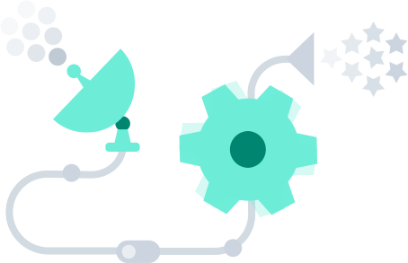
What triggers code execution?
Runs code in response to events
Event-programming model
Notes:
What is Serverless

Slide 32



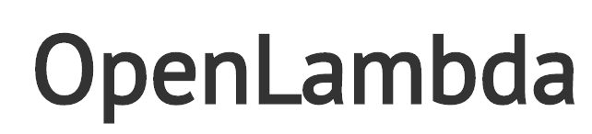



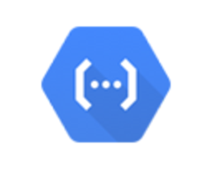



(Some) Current Platforms for Serverless
AWS Lambda
Azure Functions
Kubernetes
IBM Cloud Functions
Red-Hat
Google Functions
Notes:
Auth0, Twitter, ..
And many more upcoming / open source

Slide 33
API Gateway
33 | E6156 – Topics in SW Engineering: Lecture 5: APIs, Lambda, SSO, Events © Donald F. Ferguson, 2021

Slide 34
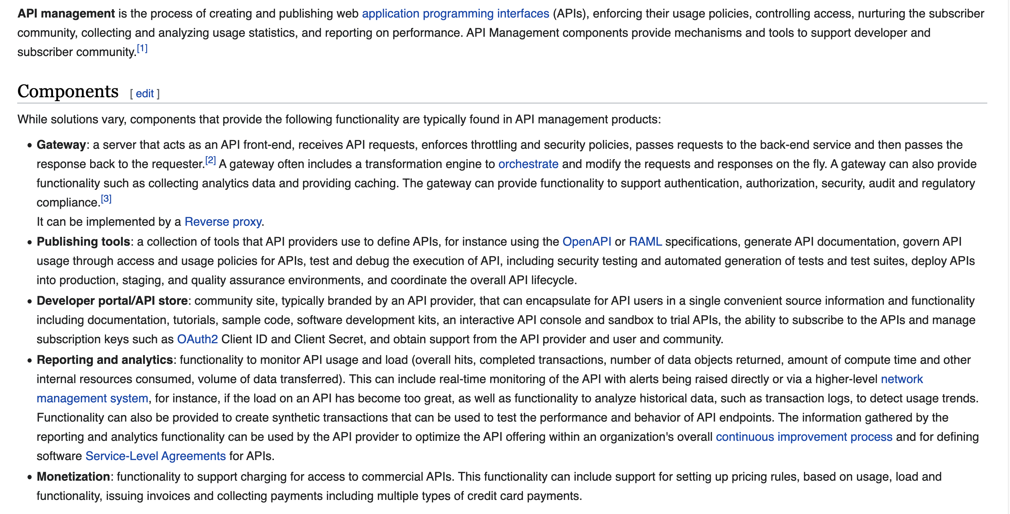
API Management

Slide 35
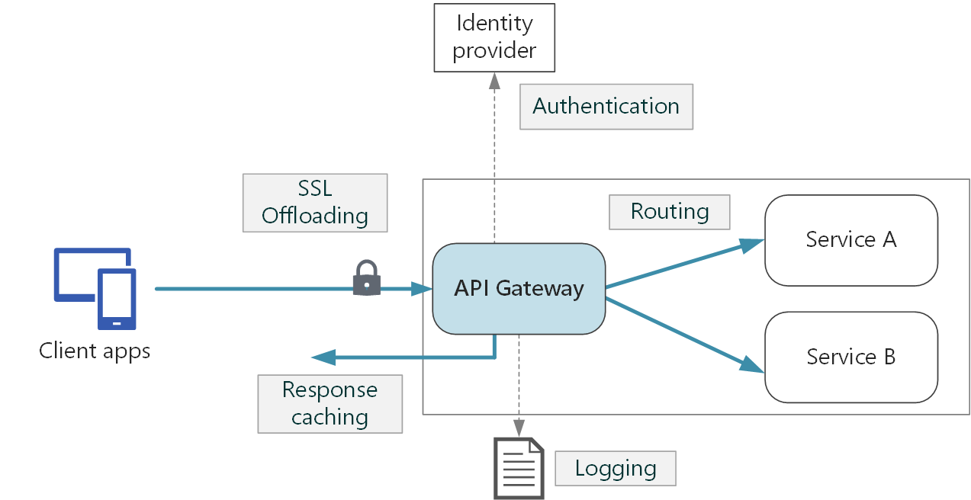
API Gateway (https://docs.microsoft.com/en-us/azure/architecture/microservices/design/gateway)
Some functions:
SSL termination
Authentication
IP allow/block list
Client rate limiting (throttling)
Logging and monitoring
Response caching
Web application firewall
GZIP compression
Servicing static content

Slide 36
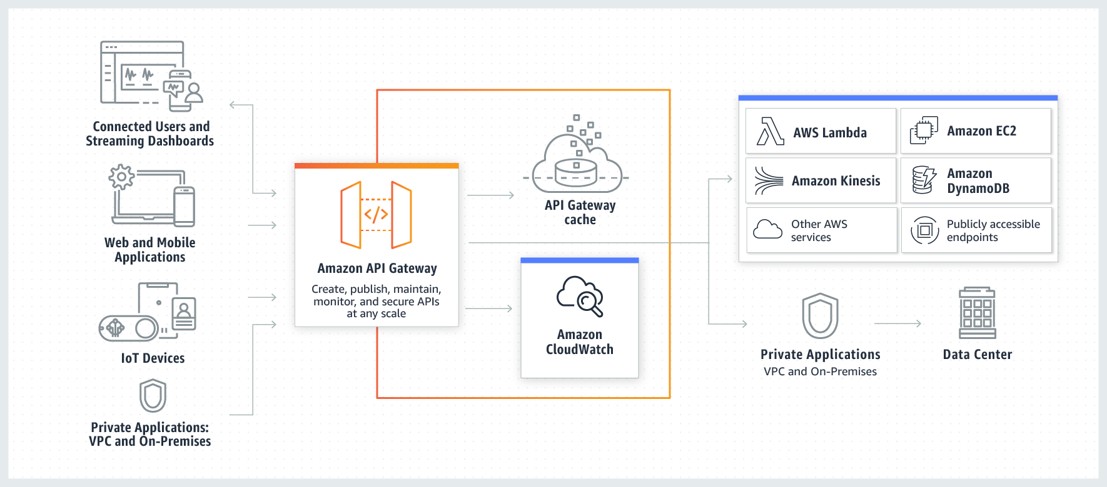
AWS API Gateway

Slide 37
Function-as-a-Service
37 | E6156 – Topics in SW Engineering: Lecture 5: APIs, Lambda, SSO, Events © Donald F. Ferguson, 2021

Slide 38
Putting Some Pieces Together
API Gateway:
We will encapsulate the 3 microservices behind the API Gateway.
Single, logical endpoint and locations for security, etc.
Events/SNS:
Setup SNS topics.
State changes in resources, e.g. user, triggers event publication.
Lambda functions handle the events and integrate with things like webhooks.
Middleware:
Add middleware to microservices to automate generating events.
Use middleware to enforce security and login, which we will later replace/complement with API GW.
Implement

